Slide 1
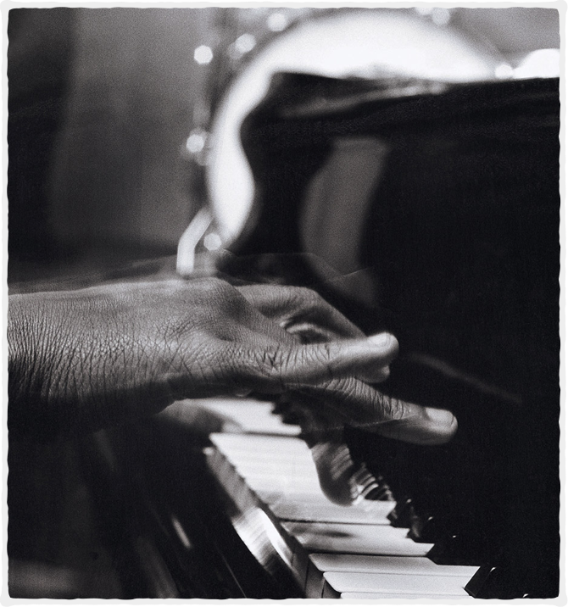
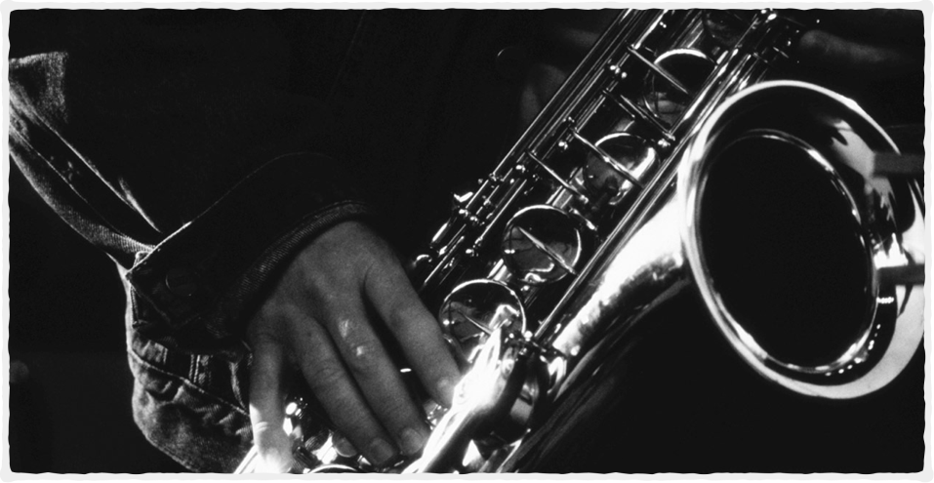

C-DAC - KNOW-IT Campus
PG Diploma in Big Data Analytics (PG-DBDA)
Presented By:-
Ritik Verma
SHUBHAM BANE
MOHIT BHAGWAT
Under the Guidance of :- TRUPTI MA’AM & ANAY SIR

Slide 2

MUSIC RECOMMENDATION
USING
MACHINE LEARNING & KAFKA INTEGRATION

Slide 3

Real Time Music Recommendation System
Music recommendation systems play a vital role in the digital music landscape, offering personalized suggestions to users based on their preferences, listening history, and behavior. These systems leverage various algorithms and techniques to analyze vast amounts of music data and provide tailored recommendations to users in Real TIme.
Where can this be helpful?
Digital streaming platforms, such as Soundcloud, Spotify, and YouTube music have drawn the interest of a great number of people, together with digital growth and the sharing of revenue from the music industry, worldwide. This demanding market, in which sustainability is challenging even for top companies, has left music service owners conscious that they need to supply their customers with not only a wide range of audio songs, but also more customized and sophisticated digital offerings on a regular basis.Nowadays an enormous number of several types of music are released each day. Managing or classifying this vast number of music manually is difficult. Machine learning models give various classification techniques for the classification of music into different genres.

Slide 4
Objectives
Converting audio file data into Digital format and extracting features like ‘Danceability’, 'Energy', 'Key', 'Loudness', 'Mode', ‘Speechiness’,’ Acousticness', 'Instrumentalness', 'Liveness', 'Valence', 'Tempo' which ML algorithms can understand i.e. Numbers
How can we leverage machine learning to recommend music based on content features i.e Training a Machine Learning model & finding optimal k clusters to classify audio files
Loading the Predicted data to MongoDb and kafka intergration to MongoDb
Querying Kafka Consumer for Consumer based logs & Recommendation such as Top Similar Songs, New hits, & Collaborative filtering (is a popular technique used in music recommendation systems. It leverages the behavior and preferences of similar users to make recommendations. For example, if two users share similar listening habits and preferences, the system may recommend songs that one user has enjoyed to the other.)

Slide 5

Key - Steps
4. Quering Kafka Consumer Logs using Pyspark-mongoDB & Kafka Integration pipeline
3. Building the machine learning model
1. Pre-Processing
2. Feature Extraction

Slide 6
Key - Steps
1. Pre-Processing

Slide 7
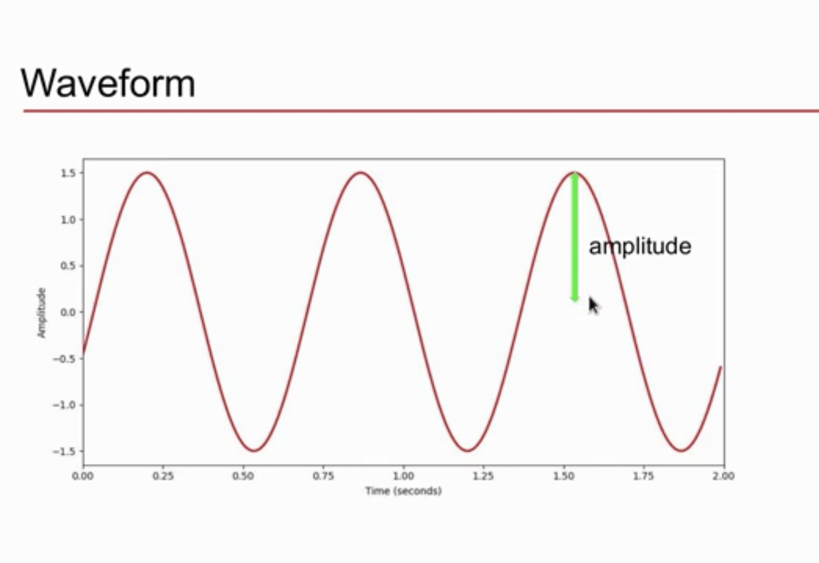
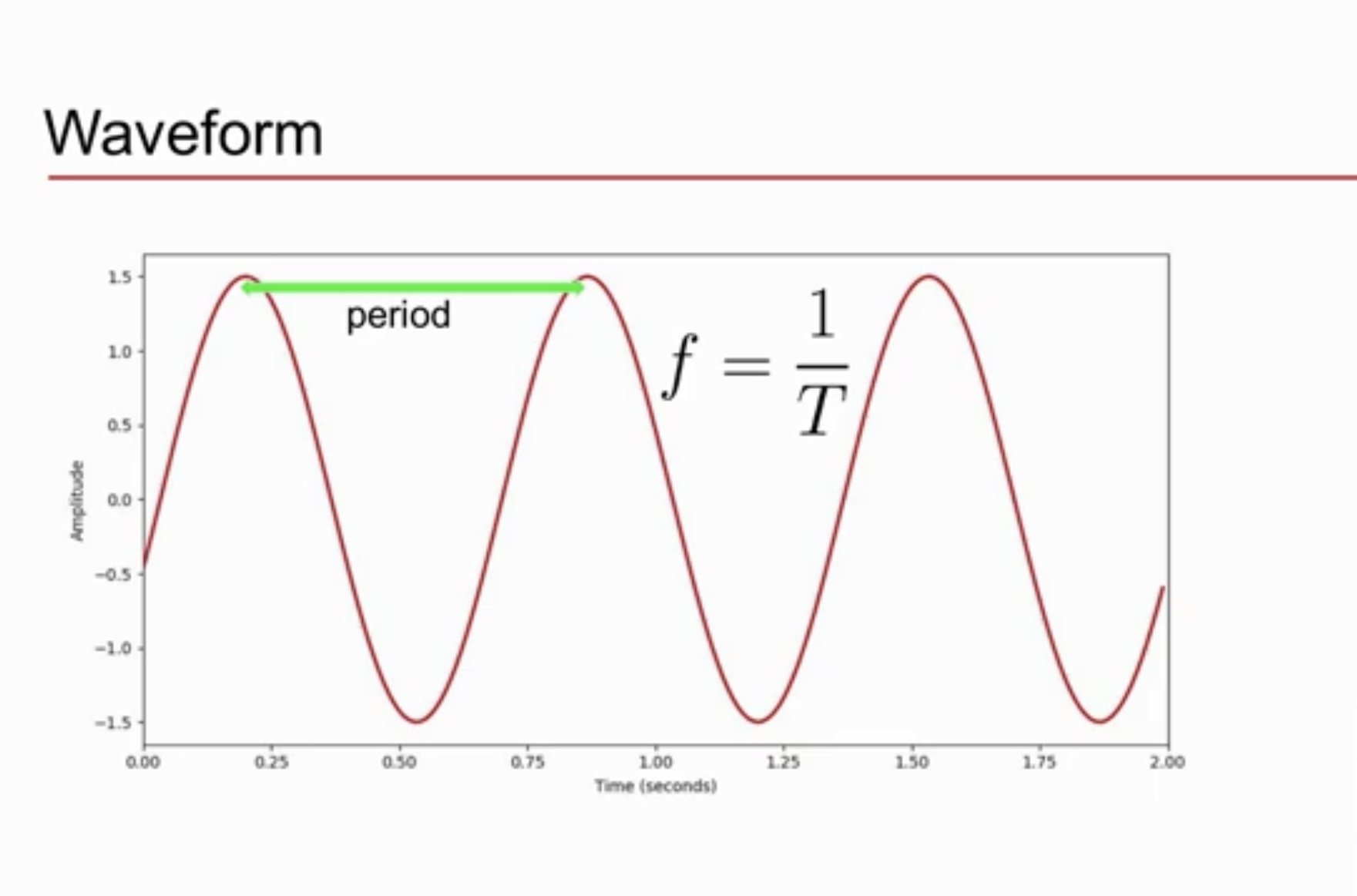
Understanding Audio Data
SOUND - produced by vibration of objects , where vibrations determine oscillation of air molecules. Alternation of air pressure causes wave.
Higher frequency of waveform amount to higher pitch of waveform.
Larger amplitude of waveform amount to loundness of waveform

Slide 8
Preprocessing audio data
Before we can use the data in the GTZAN dataset, we need to pre-process the signals so that they can be input to the Machine Learning Model. MFCC is a good representation of music signals. It is one of the best indicators of the ́’brightness ́’ of the sound. We used the Librosa library to transform the raw data from GTZAN into MFCC features.
So, we use librosa library to read the all the audio files, Input consists of audio samples from GTZAN. Row of the data consist of following features MFCC (for short term power spectrum(amplitude) of a sound), Spectral Centroid (conveys impression of the brightness of a sound), Chroma (representing 12 distinct Semitones of the musical octave which gives musical information about the audio).

Slide 9
Music Dataset
GTZAN music- genre dtaset by G.Tzanetakis and P. Cook in IEEE transactions on Audio and Speech Processing 2002
It consists of 100 audio samples per class and in total we have 10 classes
Each 16-bit mono audio file is 30 sec long sampled at 22050 Hz in (.au) format
There are 10 available genres as follows:- Rock, Hip-Hop, Metal, Blues, Classical, Pop, Jazz, Disco, Country, Reggae

Slide 10
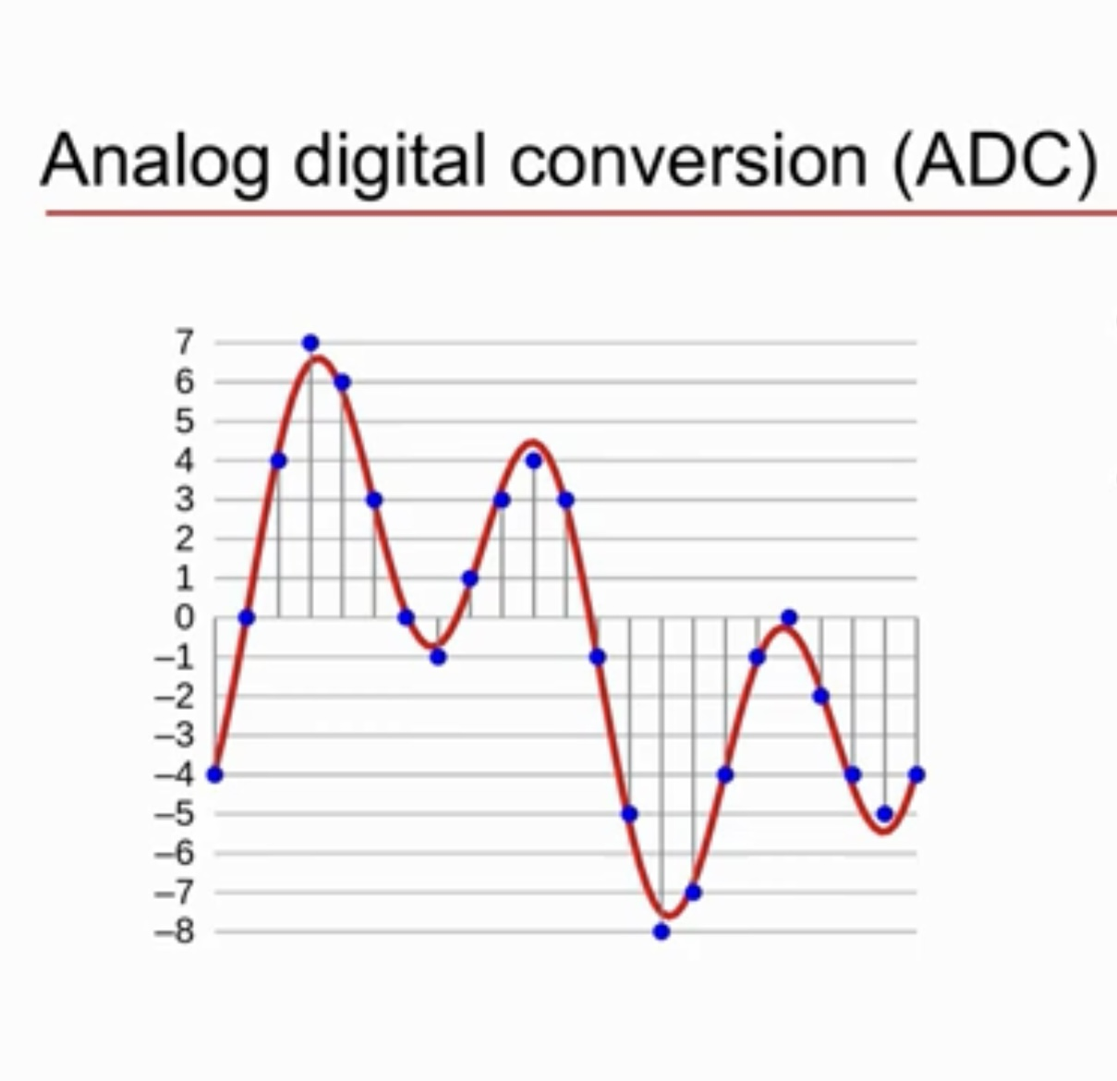
Analog digital conversion (ADC)
The most common technique to change an analog signal to digital data is called pulse code modulation (PCM). A PCM encoder has the following three processes: -(1)-Sampling -(2)-Quantization -(3)-Encoding
Signal sampled at uniform time intervals
Amplitude quantised with limited number of bits

Slide 11
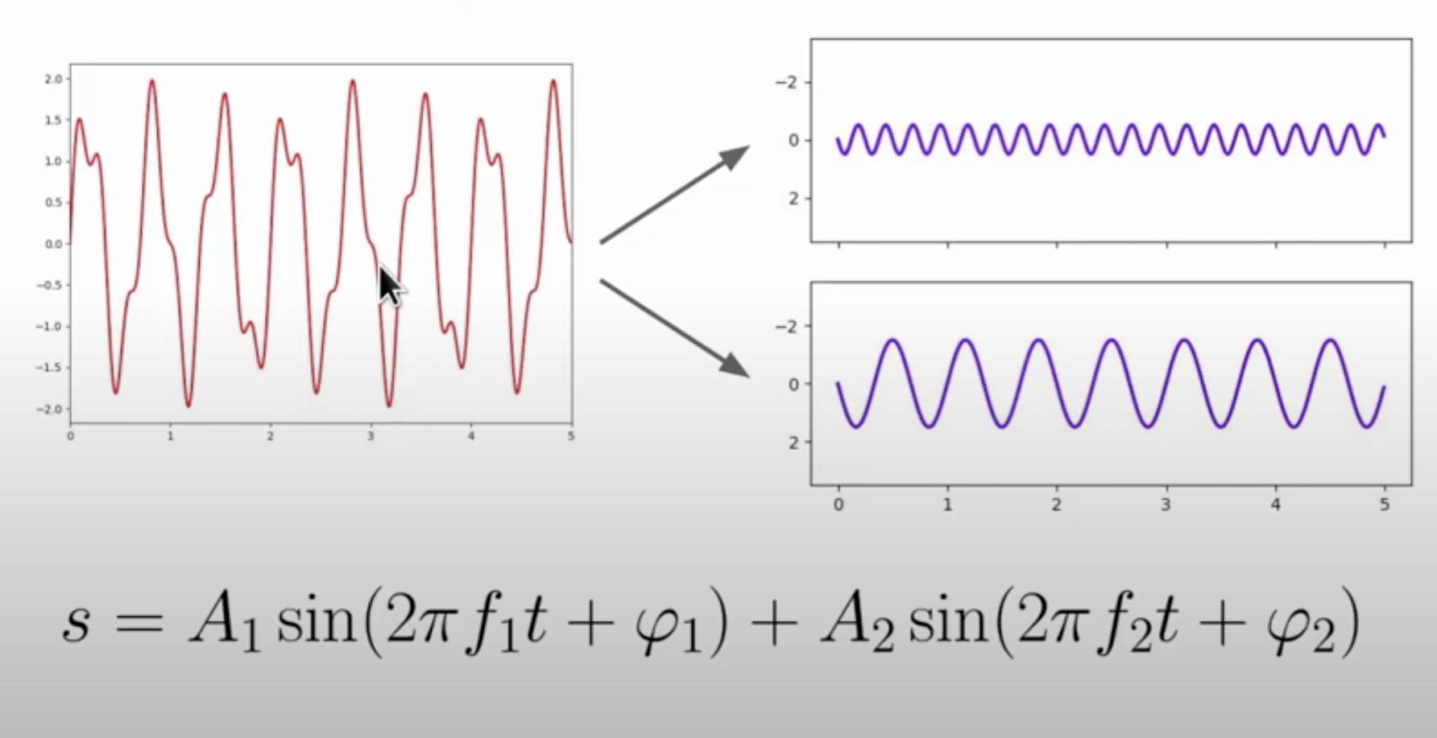
Fourier transform of a Periodic Sound
Decompose complex periodic sound into sum of sine waves oscillating at different frequencies.

Slide 12
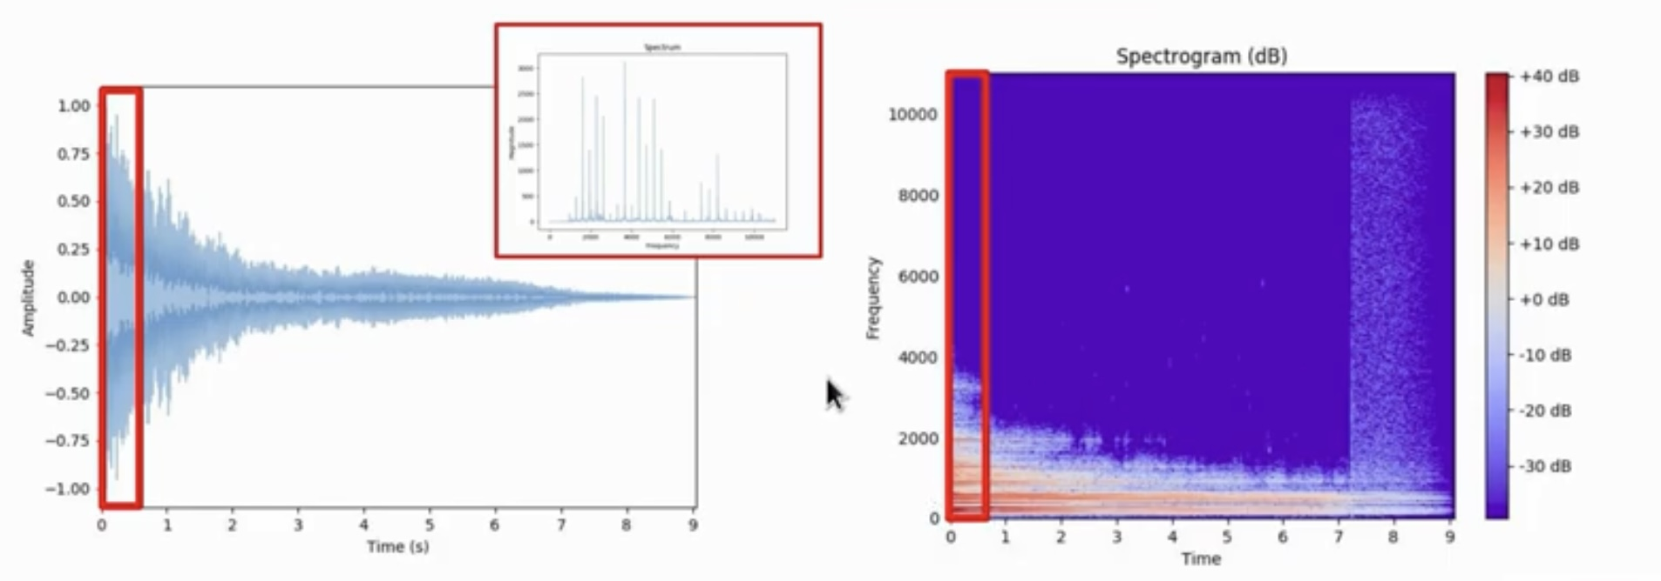
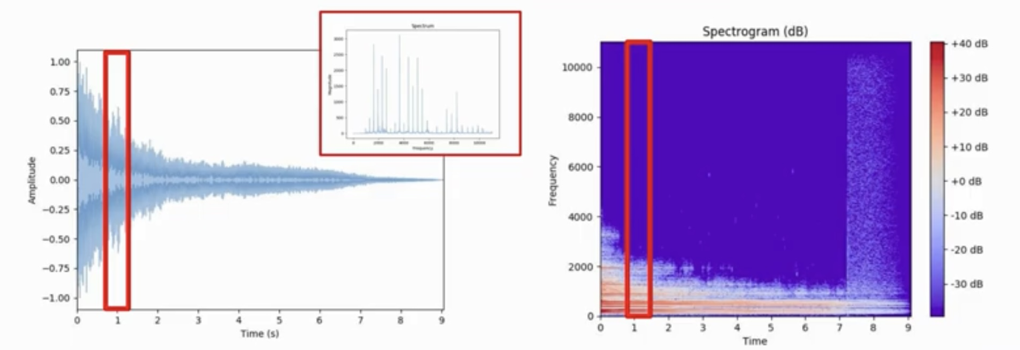
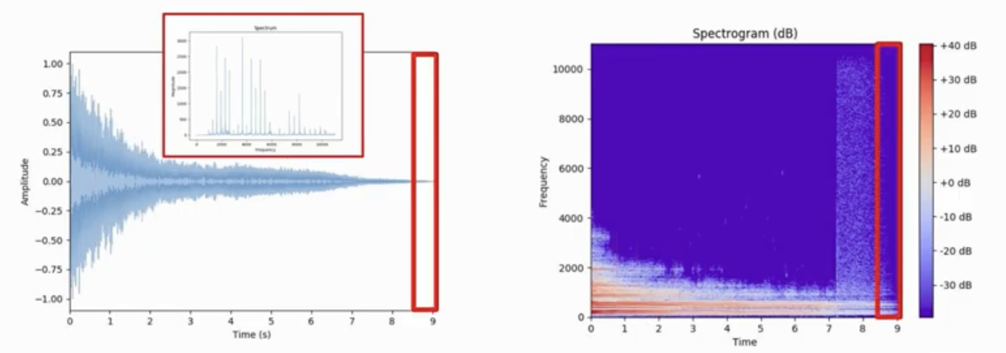
Short Time Fourier transform (STFT)
The Short-time Fourier transform (STFT), is a Fourier-related transform used to determine the sinusoidal frequency and phase content of local sections of a signal as it changes over time. In practice, the procedure for computing STFTs is to divide a longer time signal into shorter segments of equal length and then compute the Fourier transform separately on each shorter segment. This reveals the Fourier spectrum on each shorter segment. One then usually plots the changing spectra as a function of time, known as a spectrogram
Time

Slide 13
Key - Steps
1. Pre-Processing
2. Feature Extraction

Slide 14
Audio features
There are wide range of features that usually apply to sound and acoustics that could be useful for music genres . We’d go through the following features
Spectral centroid Mode
Chroma frequencies Energy and Dancebility
Spectral contrast Loudness and Instrumentalness
Mel-frequency cepstral coefficients Speechiness, Liveness

Slide 15
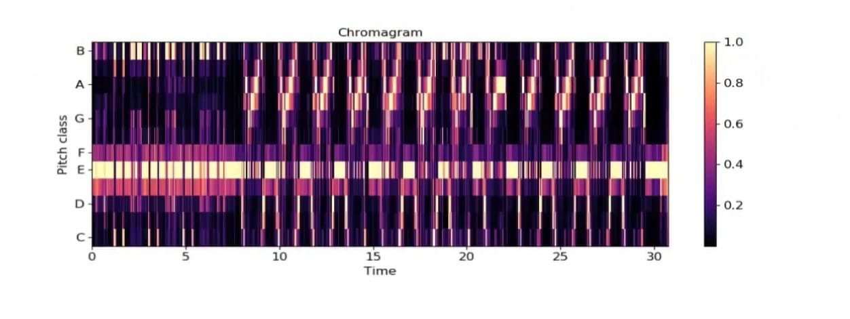
Genre - data & features
Zero- crossing rate(For Loudness and Acousticness) :- It is the rate at which the sign of the signal (above or below x-axis changes along the signal.
Chroma frequencies (For Dancebility):- These are normalized energy values for each chroma bin at each frame of the signal. Again,we take the mean of the bins at the end to add to the features.

Slide 16
Features Extraction using Librosa
Librosa is a Python package for music and audio analysis. Librosa is basically used when we work with audio data like in music generation(using LSTM’s), Automatic Speech Recognition. It provides the building blocks necessary to create the music information retrieval systems. Librosa helps to visualize the audio signals and also do the feature extractions in it using different signal processing techniques.
Conversion of audio files into numerical features.
Available methods for feature extraction
Librosa.feature.loudness()
librosa.feature.chroma_stft()
librosa.feature.acousticness()
librosa.feature.spectral _bandwidth()
librosa.feature.intrumentalness()

Slide 17
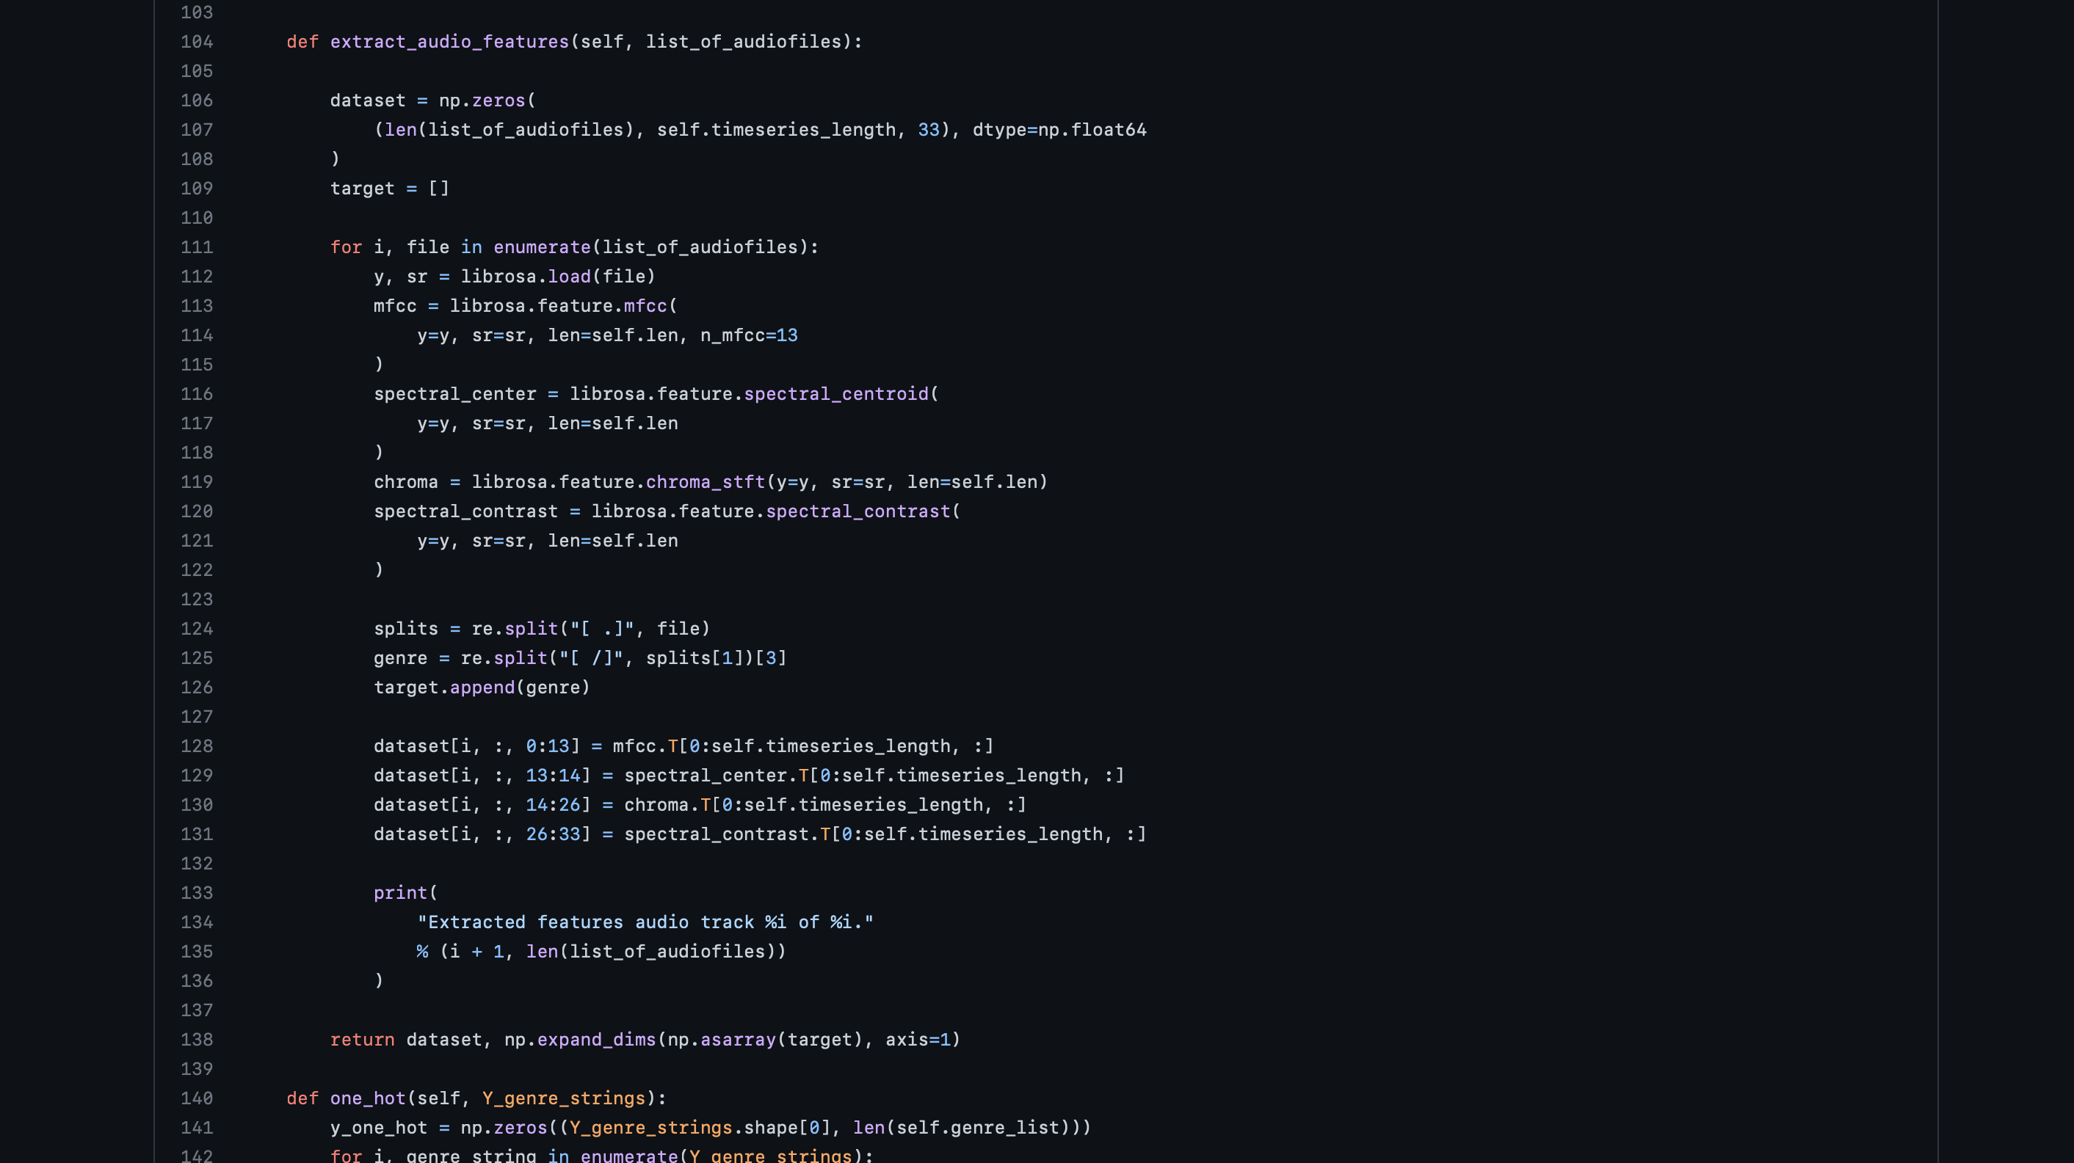
Feature Extraction using librosa

Slide 18
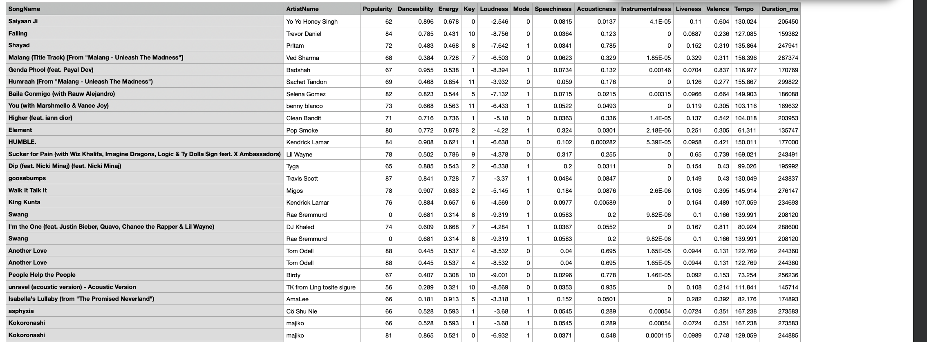
Extracted Features From Librossa

Slide 19
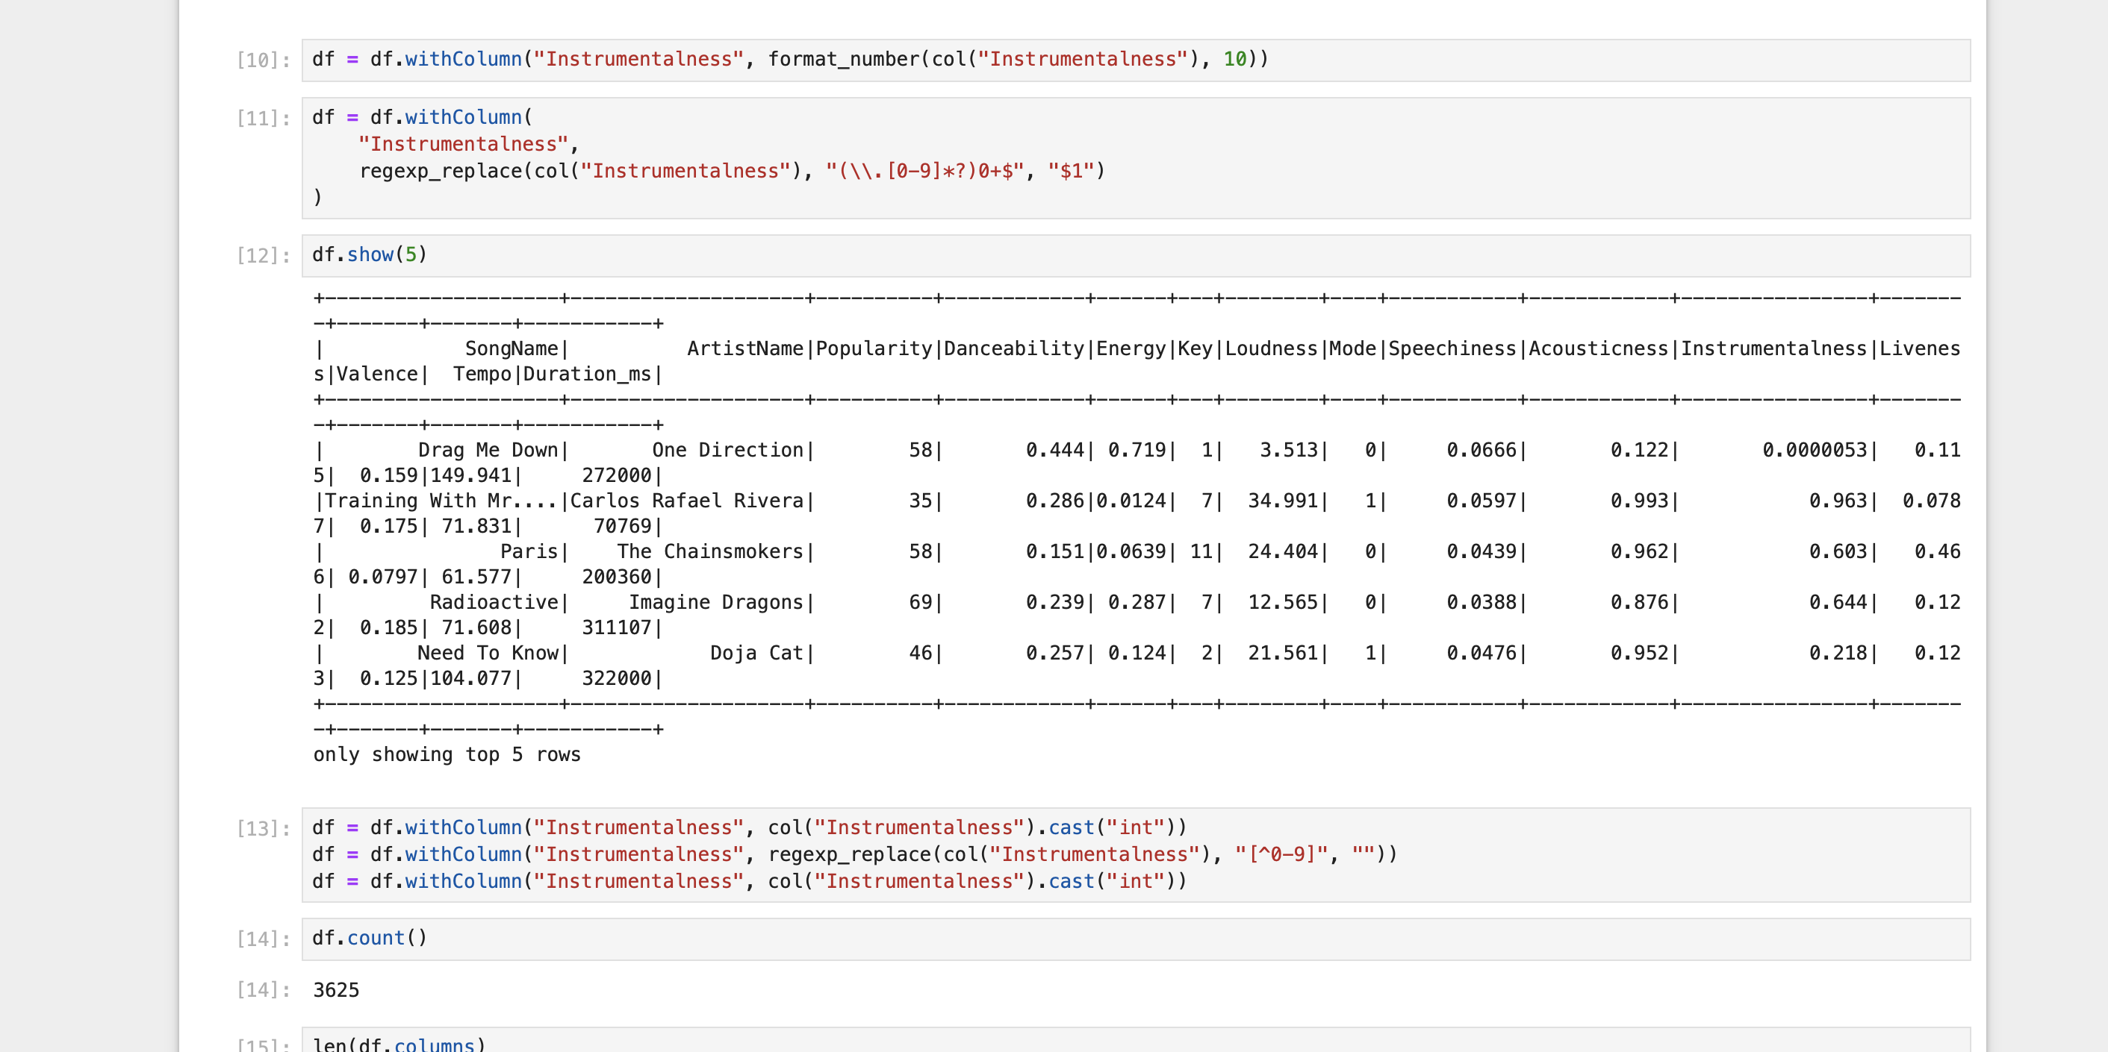
DATA Handling

Slide 20
Key - Steps
3. Building the machine learning model for Clustering
1. Pre-Processing
2. Feature Extraction

Slide 21
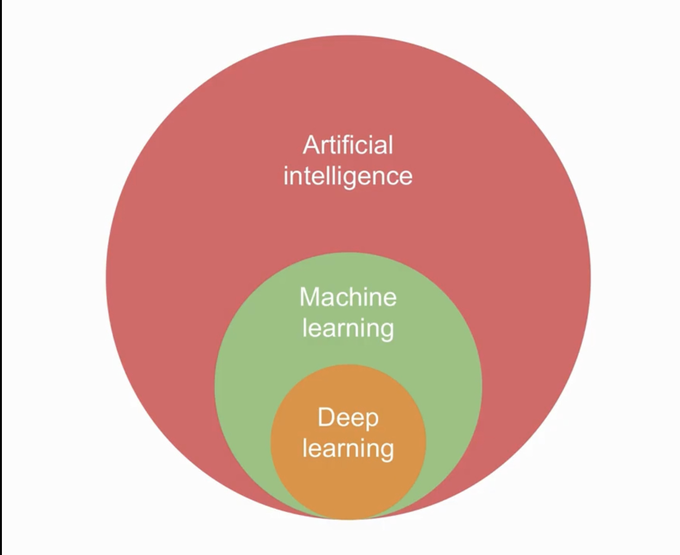
Artificial intelligence & Machine Learning
"The designing and building of intelligent agents that receive percepts from the environment and take actions that affect that environment” - Stuart Russell and Peter Nerving
Machine learning is a branch of artificial intelligence (AI) and computer science which focuses on the use of data and algorithms to imitate the way that humans learn, gradually improving its accuracy by learning from data that enables it to perform a task without using a explicit instructions .

Slide 22
System Requirements
Software Requirements Pytdub: Converts mp3 to wav files. Librosa: Speech processing library to extract features from songs. PySpark: For Data Pre processing & Machine learning software libraries. NumPy: Mathematical model for scientific computing. JSON: Used to “jsonify” the dataset. Apache Nifi : data integration platform for automation of data flow between various systems. Kafka : For Message Queuing and Pub/Sub
Hardware Requirements Operating System (Windows 10-64 bit / Linux / Mac OS) RAM- 8GB CPU-AMD AS APU / Intel i5 or upper

Slide 23
Building the Machine Learning Model
Assemble extracted features into a single vector column to Standralize them into Single output Column as Scaled Features
Perform k-means clustering for different values of k and compute WSSSE & Plot the Elbow curve & Print the Elbow point i.e optimal k & Silhouette Score.
Deploy the trained k-means model to production for real-time clustering of new data points, and send the clustering results to specific Kafka Publisher or decision-making processes.

Slide 24
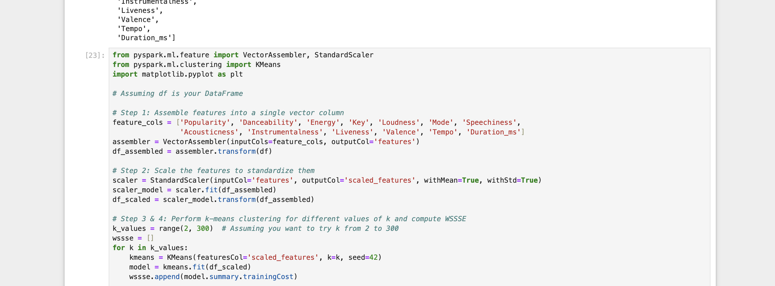
(PAM)-K-Means Clustering Model in Pyspark

Slide 25
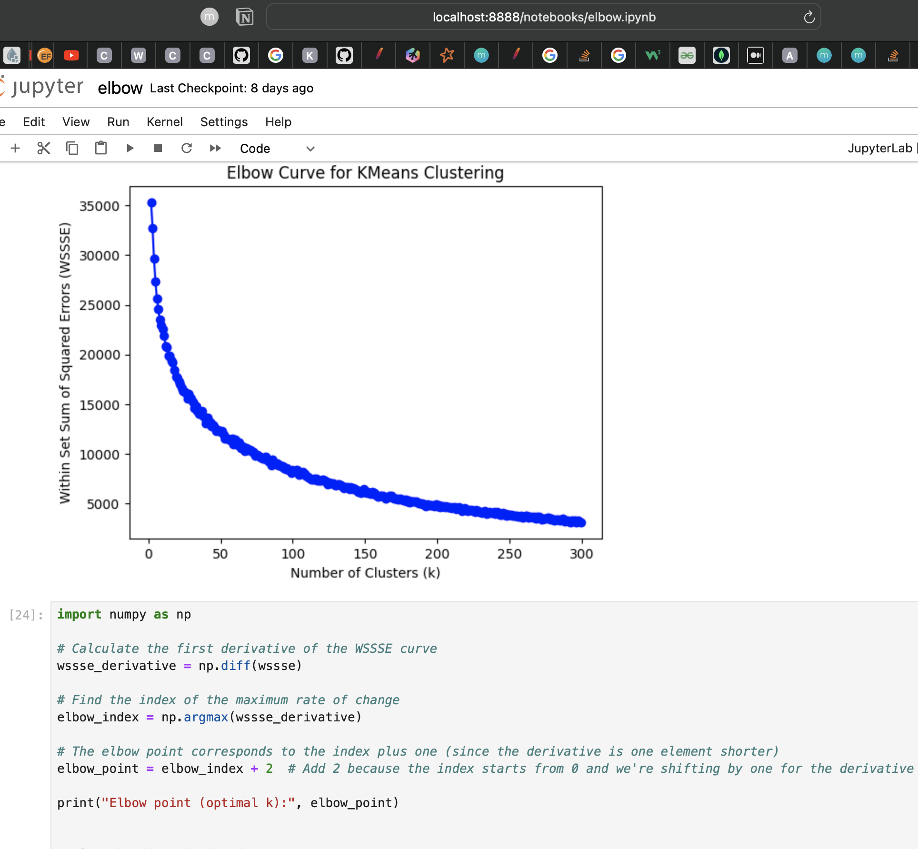
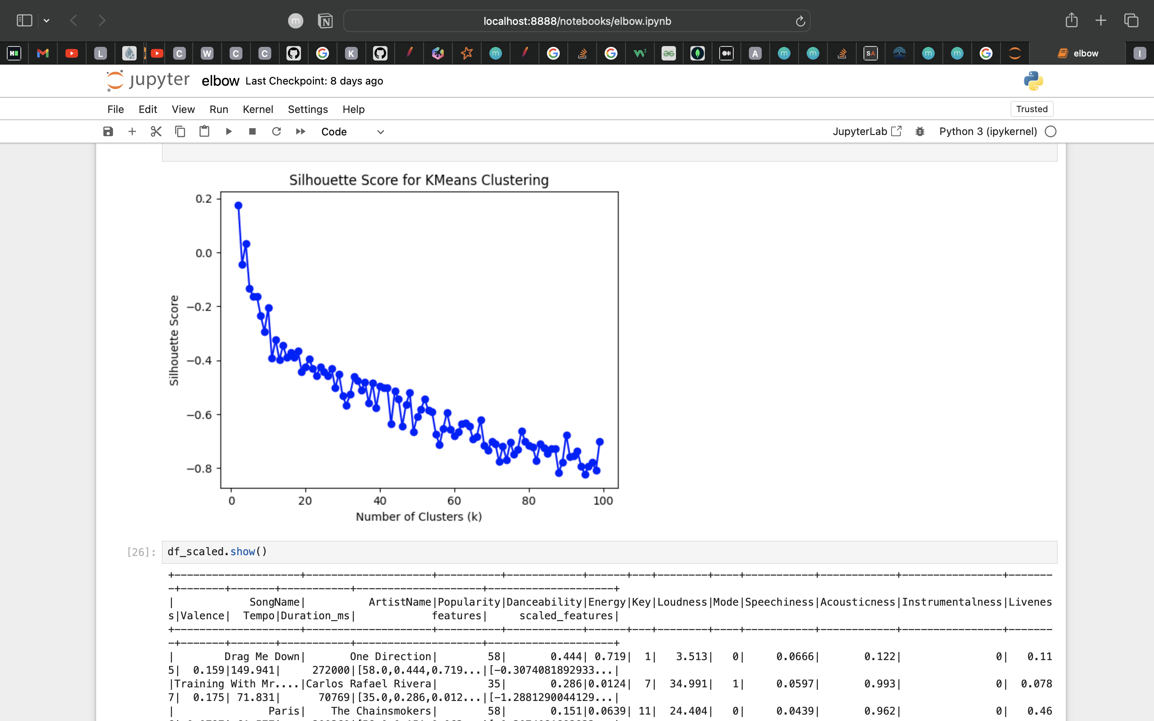
Elbow Curve And Silhouette Score

Slide 26
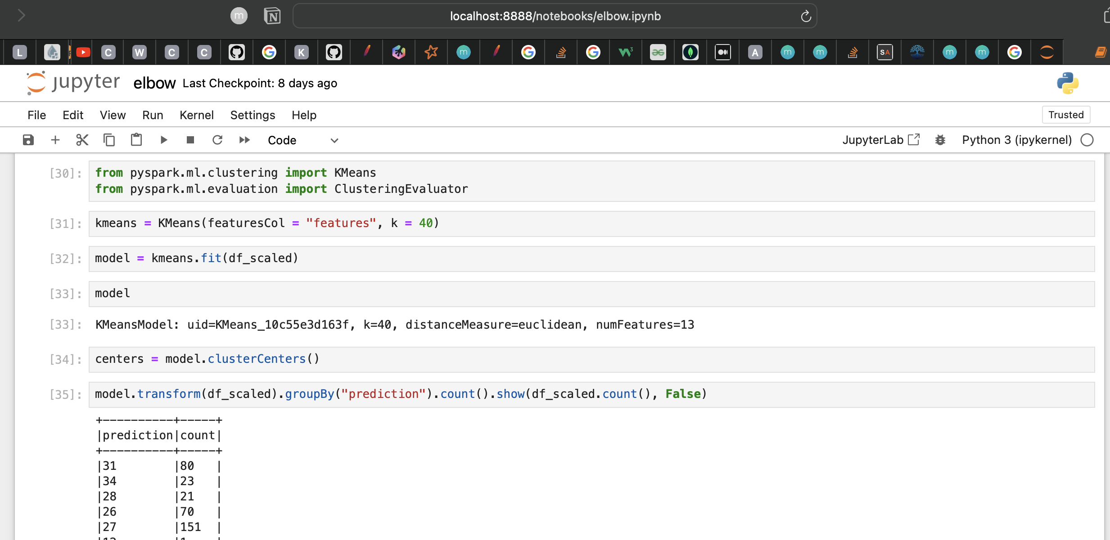
Fitting the Optimal K & Getting the Respecting Cluster no’s

Slide 27
Key - Steps
3. Building the machine learning model
1. Pre-Processing
2. Feature Extraction
4. Pyspark-mongoDB & Kafka Integration USING APACHE NIFI FLOW Quering Kafka Consumer Logs using

Slide 28
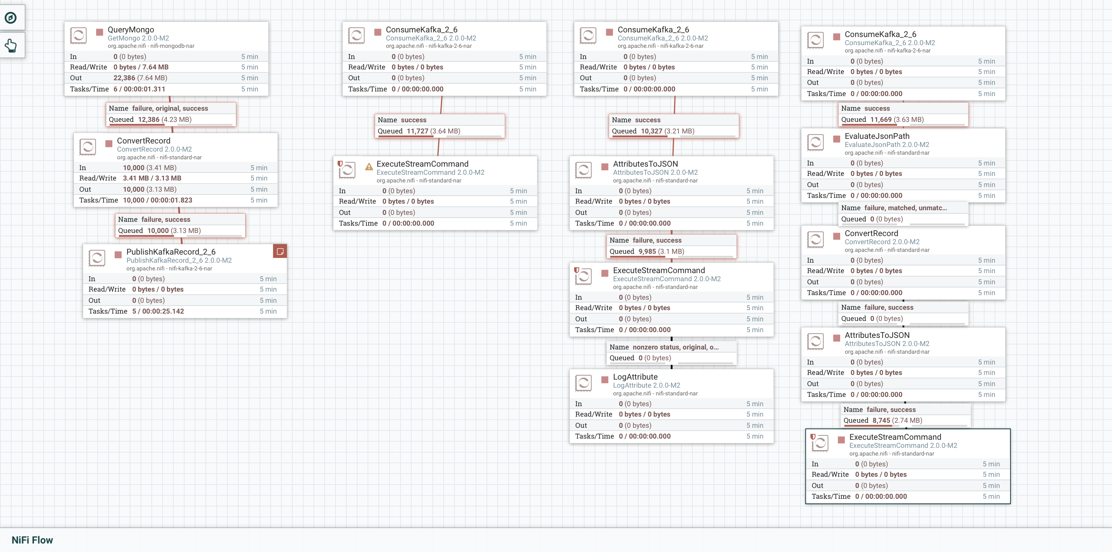
Apache Nifi Flow

Slide 29
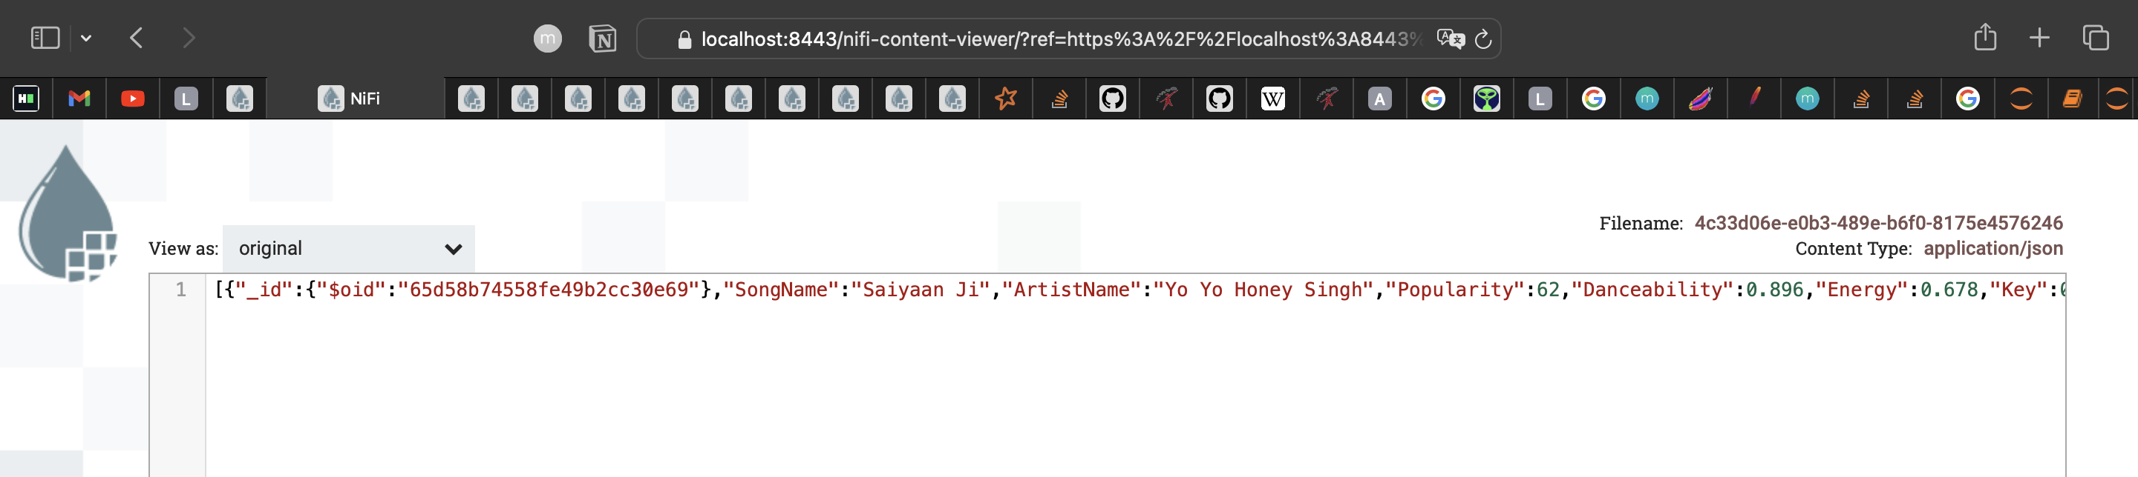
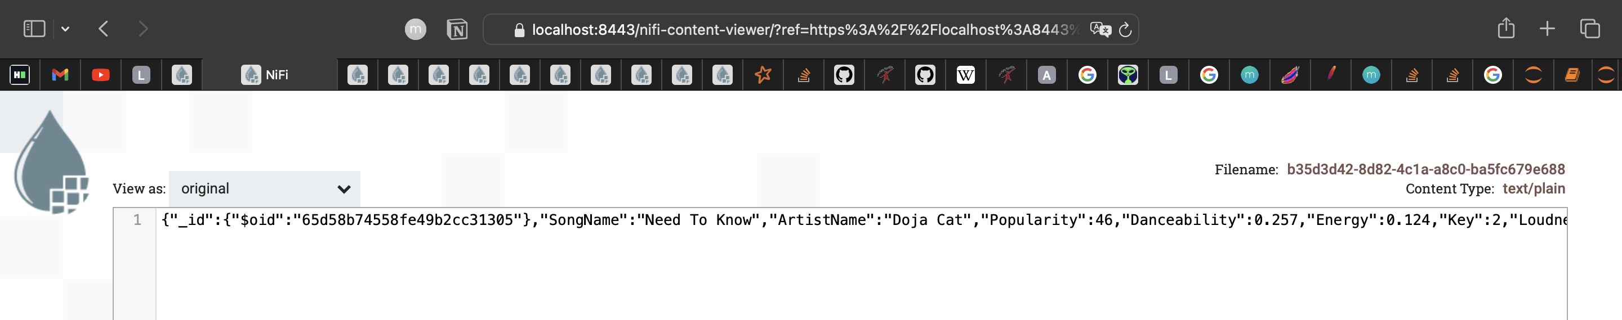
Publisher Topic & Consumer Topic

Slide 30
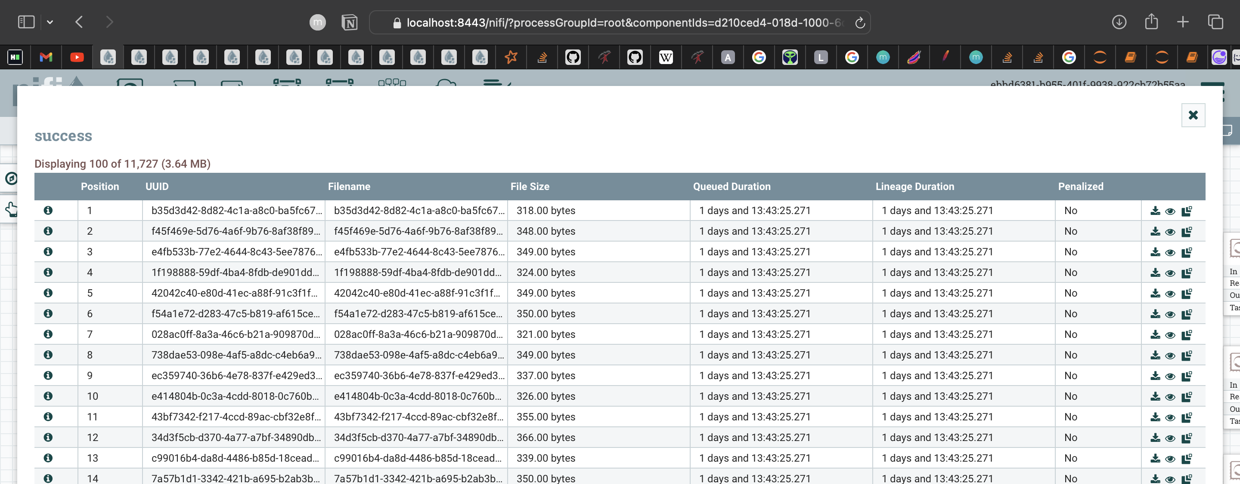
Kafka Consumer Topic Logs

Slide 31
Kafka Consumer Logs and Query
We subscribe to a Kafka topic where new music records are published.
We parse each incoming record (after converting plain/text in JSON format) to extract fields such as "releaseDate" and "popularity".
We apply filters to check if the song is newly released and if it's popular enough based on the parsed fields.
If a record passes both filters, we process it accordingly (in this case, simply printing it out).

Slide 32
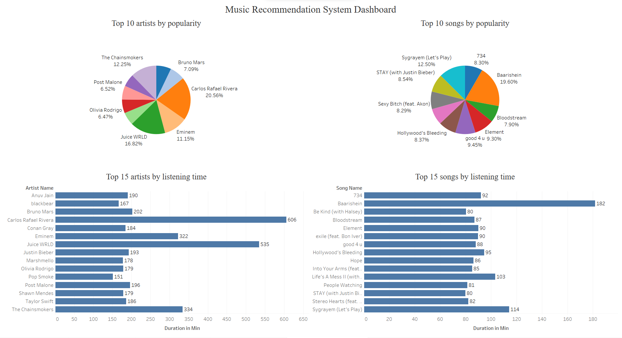
Visualization:

Slide 33
Streamlit for User Interface:
Design:
The user interface is designed to be intuitive and user-friendly.
It features search functionality, personalized recommendations, and playlist creation.
Features:
Users can search for songs, artists name .
Recommendations are displayed based on the user's preferences and cluster grouping and with album cover poster.
Playlists can be created, edited, and saved for future listening.

Slide 34
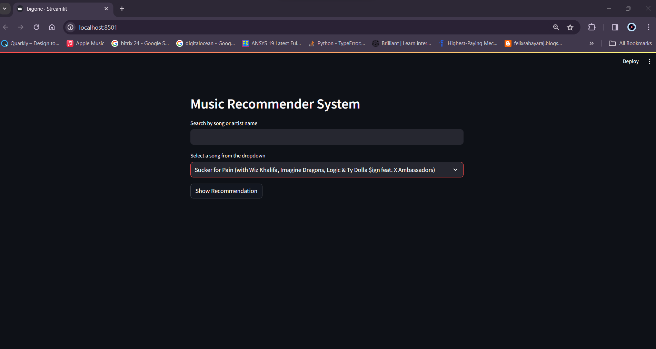

Slide 35
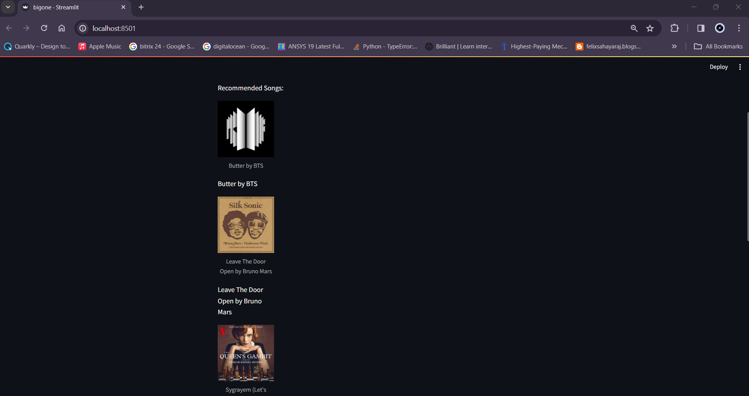

Slide 36
Conclusion:
Summary of Findings:
The music recommendation system successfully employs content-based filtering.
Users benefit from personalized music suggestions based on their preferences.
Streamlit provides an intuitive interface for easy interaction.
MongoDB and Kafka ensure efficient data storage and real-time messaging.
Future Improvements
Enhancements to recommendation algorithms for more accurate suggestions.
Integration of collaborative filtering for diverse music recommendations.
Mobile app development for on-the-go music discovery.

